Slide 1


Regional anaesthesia of the limbs in small animals
Michal Radó, Nina Bestrová, Petr Raušer
IVA VETUNI 2024FVL/1660/13

Slide 2
Table of Contents
Equipment for nerve blocks
Nerve blockages in the thoracic limb
Nerve blockages in the pelvic limb
Regional intravenous anaesthesia
Nerve blockages on the fingers

Slide 3
Equipment for nerve blocks
Needles
Hypodermic needles – surface application only
Needles with blunt atraumatic tip (30 – 45°)
Surface blockages – needles 25 – 27G
Deep blockages – needles 19 – 22G
Epidural anaesthesia
  Spinal needles 20G and 22G, length 4,5 and 7,5 cm
  Tuohy needles

Slide 4
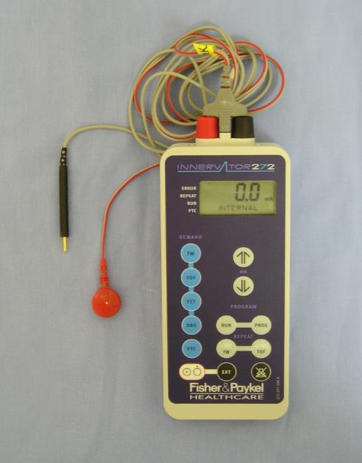
Equipment for nerve blocks
Peripheral nerve locators
Stimulation current 0.2 - 1.5 mA
Pulse duration 100 - 150 μs
Connector for needle connection
Connector for connection to a limb(

Slide 5
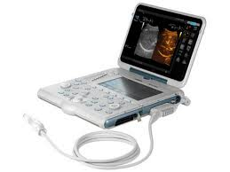
Equipment for nerve blocks
Ultrasound
Linear probes
Viewing of structures up to 5 cm depth
  high frequency probes 10 – 15 MHz
View deeper structures
  4 – 7 MHz probes
Colour Doppler
  Differentiation of vascular structures

Slide 6
Drugs for nerve blockade
Local anaesthetics
Lidocaine, bupivacaine, Ropivacaine, ...
  Excitation line blockage
Opioids
Morphine, methadone, fentanyl, sufentanil...
  Supraspinal, spinal, antinociceptive effects
Alpha-2 adrenergic agonists
Dexmedetomidine
  Extension of blockade time

Slide 7
Blockages on the thoracic limb
Intra-articular analgesia of the shoulder joint
Intra-articular analgesia of the elbow joint
Blockade of the plexus brachialis
RUMM block

Slide 8
Intra-articular analgesia of the shoulder joint
Indications
Intra-articular procedures in the elbow joint
Equipment
Sterile gloves, aids for preparation of the operating field
Syringes, needles
Lidocaine or bupivacaine

Slide 9
Intra-articular analgesia of the shoulder joint
Blockade procedure
We palpate tuberculum majus humeri and acromion scapulae
Palpate the space craniodistally to the acromion scapulae.
From the centre of the acromion scapulae, insert the needle at an angle of 70° caudomedially
The joint slot is filled with analgesic until the resistance of the syringe plunger is felt
We inject lidocaine or bupivacaine alone or with morphine

Slide 10
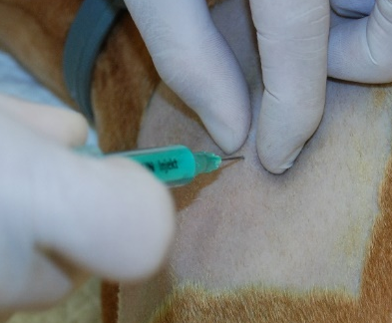
Intra-articular analgesia of the shoulder joint
Acromion scapulae
Tuberculum majus humeri

Slide 11
Intra-articular analgesia of the elbow joint
Indications
Intra-articular procedures in the elbow joint
Equipment
Sterile gloves, aids for preparation of the operating field
Syringes, needles
Lidocaine or bupivacaine

Slide 12
Intra-articular analgesia of the elbow joint
Blockade procedure
We are burning epicondylus humeri and proc. anconeus ulnae
Palpate the articular cleft distally below the epicondylus medialis humeri, insert the needle caudally
The joint slot is filled with analgesic until the resistance of the syringe plunger is felt
We inject lidocaine or bupivacaine alone or with morphine

Slide 13
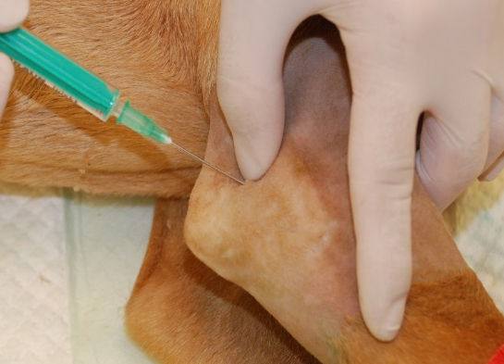
Intra-articular analgesia of the elbow joint
Processus anconeus ulnae
Epicondylus lateralis humeri

Slide 14
Blockade of the plexus brachialis
Indications
Interventions distal to the middle part of the humerus
Equipment
Neurolocator
Neurostimulation needle 22G, 50 mm for small breeds or 21G 100 mm for large breeds.
Sterile gloves, surgical field preparation equipment, syringes, needles
Lidocaine or bupivacaine, dexmedetomidine

Slide 15
Blockade of the plexus brachialis
Blockade procedure
Lateral position, blocked limb on top
Palpation of the shoulder joint, acromion scapulae, tuberculum majus humeri, trachea, vena jugularis and first rib
The injection site is cranial to the acromion scapulae and medial to the m. subscapularis
The needle is inserted caudomedially towards the scapula

Slide 16
Blockade of the plexus brachialis
Blockade procedure
When the needle is inserted correctly, stimulation of the n. musculocutaneus causes contraction of the m. biceps brachii and flexion of the elbow
Contractions must be inducible with a current of 0.4 mA
Inject 0.25 - 0.3 ml/kg lidocaine or bupivacaine alone or with dexmedetomidine

Slide 17
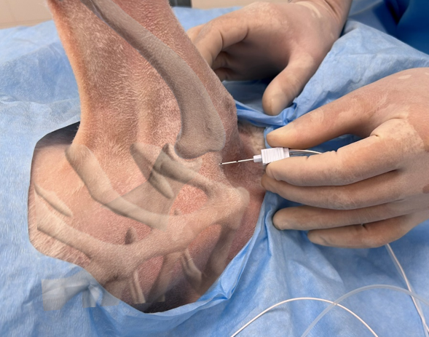
Blockade of the plexus brachialis
Tuberculum supraglenoidale
Manumbrium sterni

Slide 18
RUMM block
Indications
Interventions distal to the elbow
Equipment
Neurolocator
Neurostimulation needle 22G 50 mm
Sterile gloves, surgical field preparation equipment, syringes, needles
Lidocaine or bupivacaine, dexmedetomidine

Slide 19
RUMM block
Blockade procedure
Palpation of the elbow joint, tuberculum maius humeri, epicondylus humeri, caput laterale and mediale of m. triceps brachii and m. brachialis, m. biceps brachii and a. brachialis
The puncture site for the blockade of the n. radialis is on the caudolateral side of the humerus between the caput longum of m. triceps brachii and m. brachialis at the level between the middle and distal third of the humerus

Slide 20
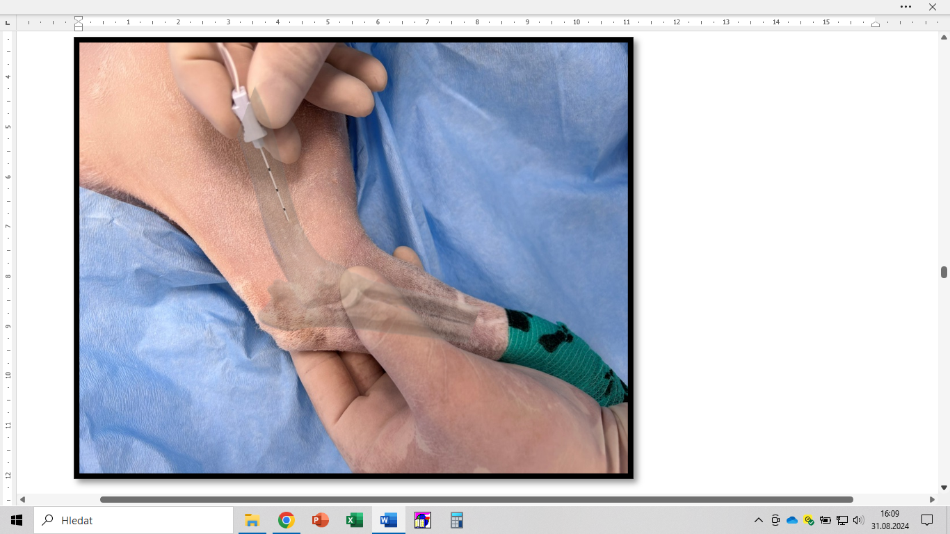
RUMM block - blockade of the n. radialis
M. brachialis
Caput longum m. triceps brachii

Slide 21
RUMM block
Blockade procedure
The injection site for the blockade of the n. ulnaris, n. medianus and n. musculocutaneus is on the medial side
The a. brachialis pulse can be palpated proximal to the elbow joint between the m. biceps and the caput mediale of the m. triceps brachii
The injection site is in the middle of the humerus cranially and caudally from the a. brachialis
Inject lidocaine or bupivacaine alone or with dexmedetomidine

Slide 22
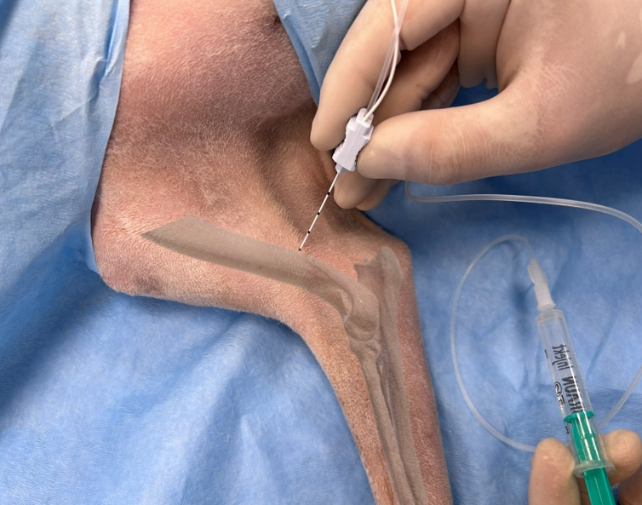
RUMM block - blockade of n. ulnaris, n. medianus and n. musculocutaneus
Caput mediale m. triceps brachii
M. Biceps brachii

Slide 23
RUMM block - distal blockade
Blockade procedure
For procedures distal to the carpus
To block the dorsal branch of the n. ulnaris, we insert the needle lateral to the accessory carpal pad
To block the n. radialis, insert the needle dorsomedially from the carpus just proximal to the carpal joint
We inject lidocaine or bupivacaine

Slide 24
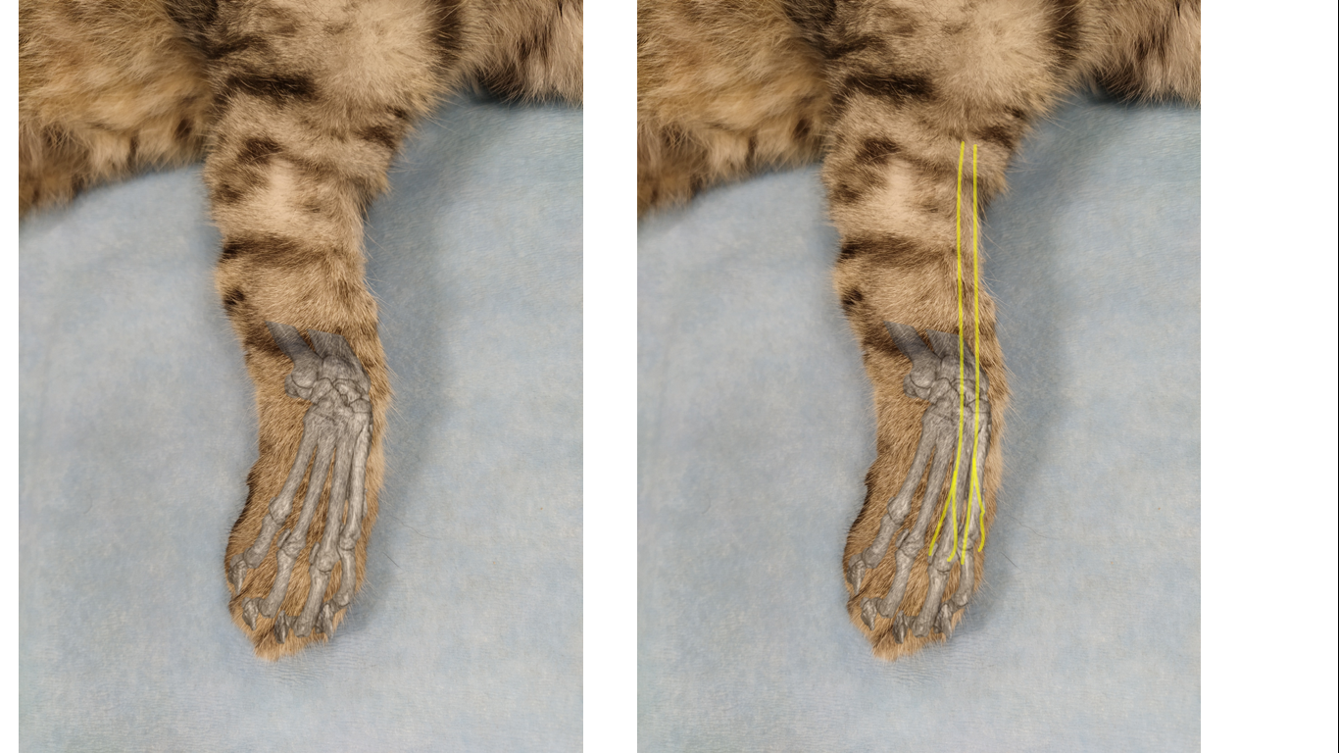
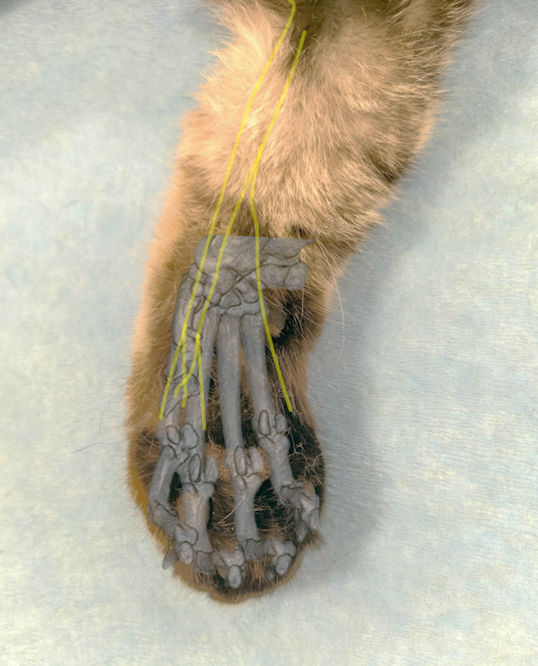
RUMM block - distal blockade

Slide 25
Blockages on the pelvic limb
Intra-articular analgesia of the hip joint
Intra-articular analgesia of the knee joint
Epidural anaesthesia
Blockade of the nervus ischiadicus
Blockade of the nervus femoralis

Slide 26
Intra-articular analgesia of the hip joint
Indications
Intra-articular procedures in the hip joint
Equipment
Sterile gloves, aids for preparation of the operating field
Syringes, needles
Lidocaine or bupivacaine

Slide 27
Intra-articular analgesia of the hip joint
Blockade procedure
Palpate the trochanter major femoris
Animal in lateral position with affected limb on top, knee in neutral position and 30° of hip flexion
Palpation of the trochanter major femoris, injection site 5 mm cranially and 15 mm proximal to it
Absence of synovial leakage does not preclude correct needle position
Inject 1 – 6 ml of lidocaine or bupivacaine

Slide 28
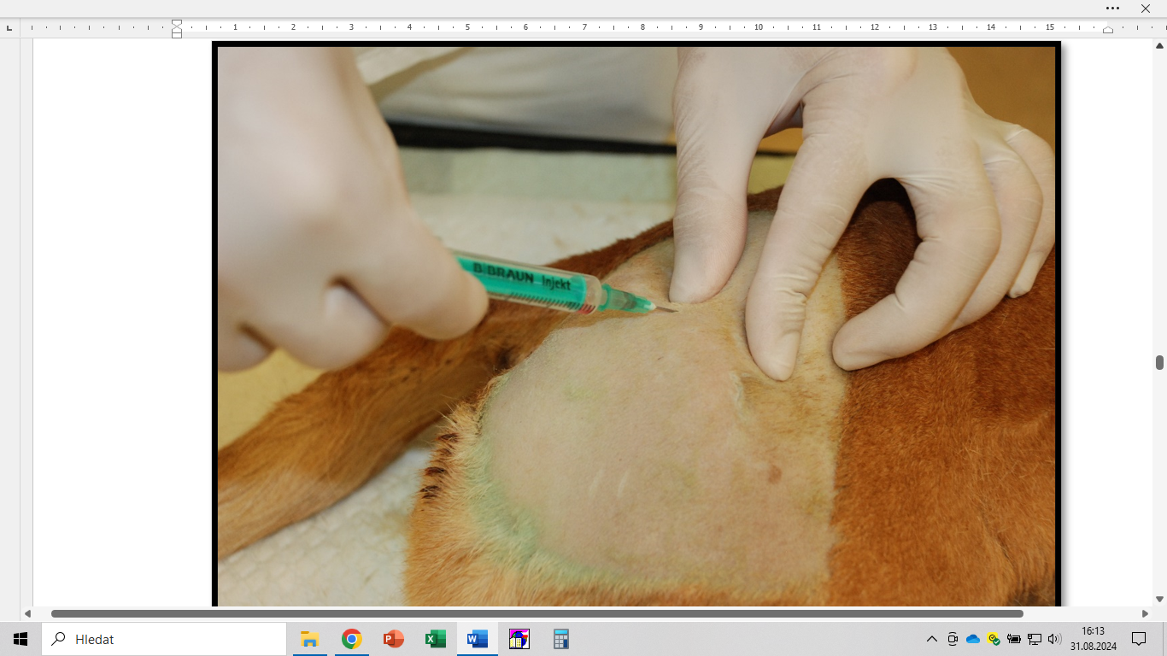
Intra-articular analgesia of the hip joint
Trochanter major femoris

Slide 29
Intra-articular analgesia of the knee joint
Indications
Intra-articular procedures in the knee joint
Equipment
Sterile gloves, aids for preparation of the operating field
Syringes, needles
Lidocaine or bupivacaine

Slide 30
Intra-articular analgesia of the knee joint
Blockade procedure
Palpation of the patella, lig. patellae and tuberositas tibiae
Animal in dorsal or lateral position, knee joint in flexion.
Insert the needle laterally from the lig. patellae halfway between the cranial edge of the patella and the tuberositas tibiae
Absence of synovial leakage does not preclude correct needle position
Inject 1 – 6 ml of lidocaine or bupivacaine

Slide 31
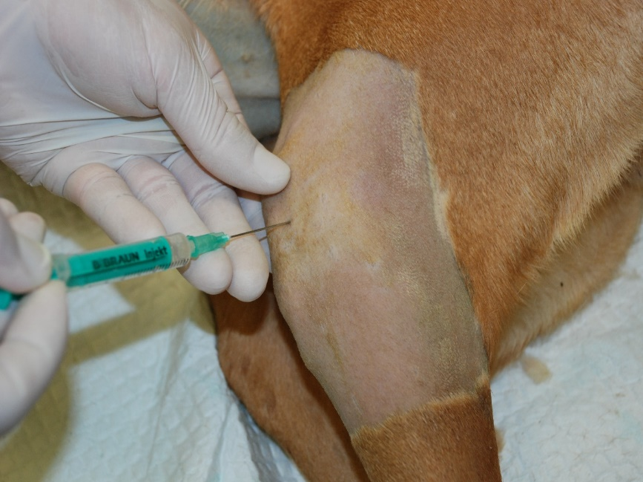
Intra-articular analgesia of the knee joint
Ligamantum patellae
Tuberositas tibiae

Slide 32
Epidural anaesthesia
Indications
Abdominal, pelvic, perineum, tail and pelvic limb procedures
Equipment
Sterile gloves, aids for preparation of the operating field
Resistless syringes, spinal needles 20 – 22G
Lidocaine, bupivacaine, morphine, methadone, fentanyl, dexmedetomidine, ketamine

Slide 33
Epidural anaesthesia
Blockade procedure
We're palpating ala ossis ilii and proc. spinosus L7 and S1
Animal in lateral or sternal position
Injection perpendicular to the skin in the median line caudally behind the proc. spinosus L7
Penetration of leagues. Interspinosum perceived by significant resistance
Sudden loss of resistance ("peeling") signals penetration into the epidural space

Slide 34
Epidural anaesthesia
Blockade procedure
Zero resistance of the needleless syringe indicates correct placement of the needle tip
During injection, there is no compression of the air bubble under the syringe plunger
To achieve blockade after L1, inject 1 ml/5 kg body weight
To achieve pelvic limb blockage, inject 1 ml/7 kg

Slide 35
Drugs for epidural anaesthesia
Drugs | Dose (mg/kg) | Entry (min) | Action (h)
Lidocaine | 4.4 | 2 | 2
Bupivacaine | 0.14 – 0.22 | 5 | 2.5
Morphine | 0.1 | 30 – 60 | 6 – 24
Methadone | 0.3 | 30 – 40 | 8 – 12
Fentanyl | 0.005 – 0.01 | 20 – 40 | 7 – 10
Dexmedetomidine | 0.004 – 0.002 | 20 – 30 | 4 – 6
Ketamine | 0.6 – 2.5 |  | 1,5

Slide 36
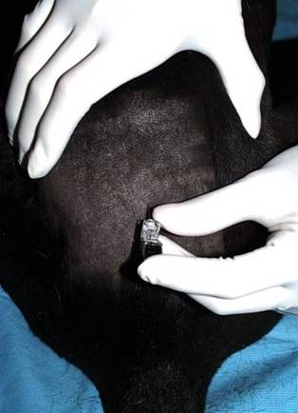
Epidural anaesthesia
Ala ossis illii
L7-S1
Ala ossis illii

Slide 37
Blockade of n. ischiadicus
Indications
Partial numbness of the knee and structures distal to it
Equipment
Neurolocator, neurostimulation needle 22G, 50 mm
Sterile gloves, surgical field preparation equipment, syringes, needles
Lidocaine or bupivacaine, dexmedetomidine

Slide 38
Blockade of n. ischiadicus
Blockade procedure
Animal lying on the opposite side
We're palpating the trochanter major and the ischial tuberosity.
Insert the needle at the junction of these points between the cranial and middle third of the distance at a 45° angle
Stimulate with 0.4 mA current
Inject bupivacaine with dexmedetomidine 0.05 – 0.1 ml/kg

Slide 39
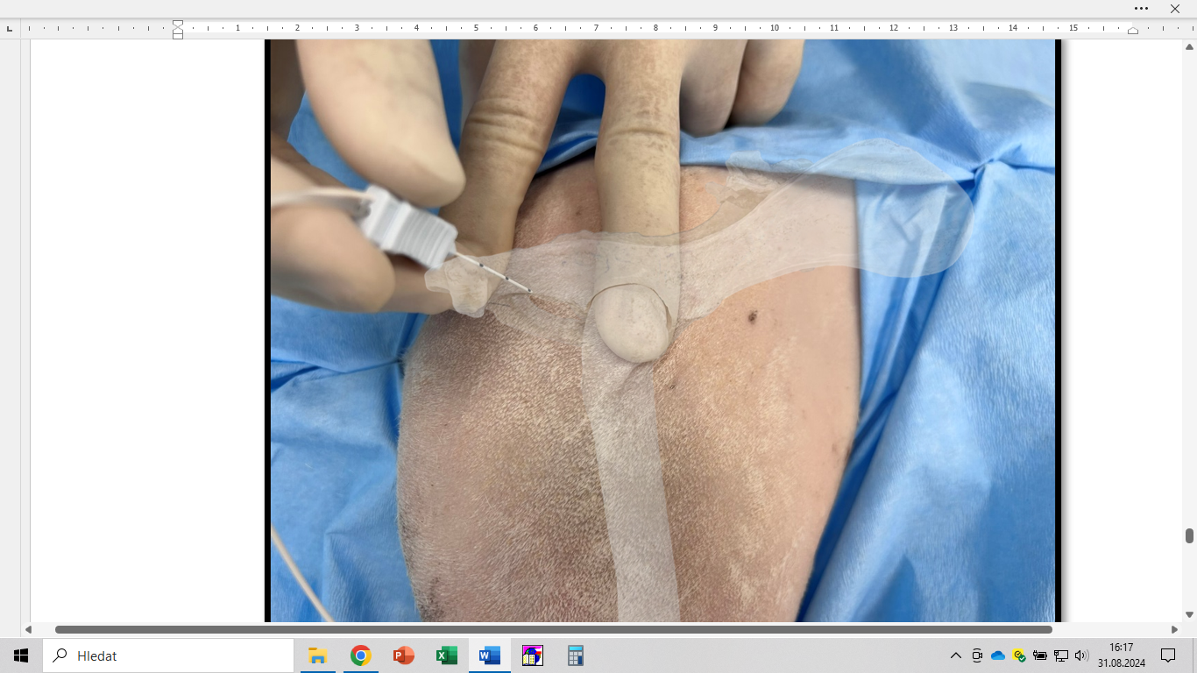
Blockade of n. ischiadicus
Tuber ischiadicum
Trochanter major

Slide 40
Blockade of the n. femoralis
Indications
Procedures on the craniomedial and dorsomedial parts of the limb distal to the medial part of the femur
Equipment
Neurolocator, neurostimulation needle 22G, 50 mm
Sterile gloves, surgical field preparation equipment, syringes, needles
Lidocaine or bupivacaine, dexmedetomidine

Slide 41
Blockade of the n. femoralis
Blockade procedure
Animal lying on the opposite side
The femoral triangle is defined by m. pectineus, m. sartorius and m. iliopsoas, n. femoralis cranial to a. femoralis
The needle is inserted in the femoral triangle cranially from the a. femoralis towards the m. iliopsoas at an angle of 20 – 30°, stimulated with a current of 0.4 mA
Inject bupivacaine with dexmedetomidine 0.05 – 0.1 ml/kg

Slide 42
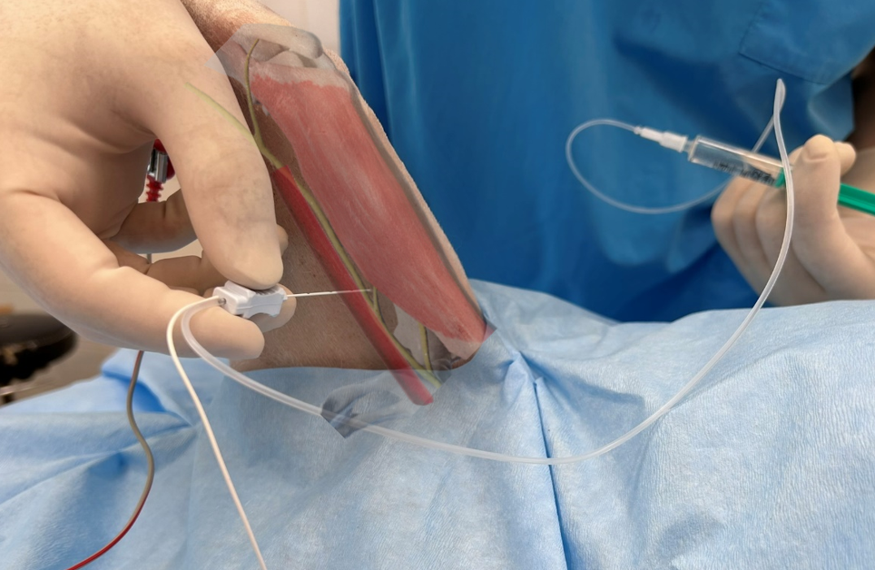
Blockade of the n. femoralis
A. et v. femoralis
M. sartorius

Slide 43
Regional intravenous anaesthesia
Equipment
Sterile gloves, aids for preparation of the operating field
Syringes, needles, intravenous catheters (22 – 25G).
Lidocaine or bupivacaine 0.6 ml/kg
Choke or turnstile

Slide 44
Regional intravenous anaesthesia
Blockade procedure
Insert an intravenous catheter as distally as possible
Exsanguinate the limb with an elastic bandage
Proximally attach the tourniquet
Remove the bandage used to bleed
We inject lidocaine
We'll remove the catheter
Remove the tourniquet after the procedure

Slide 45
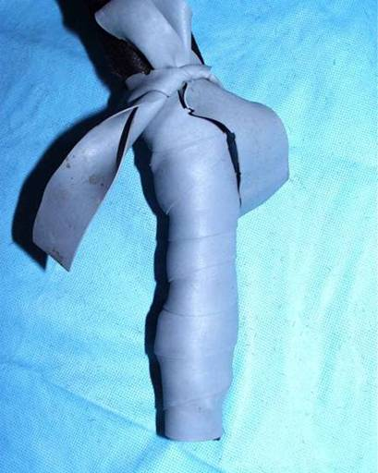
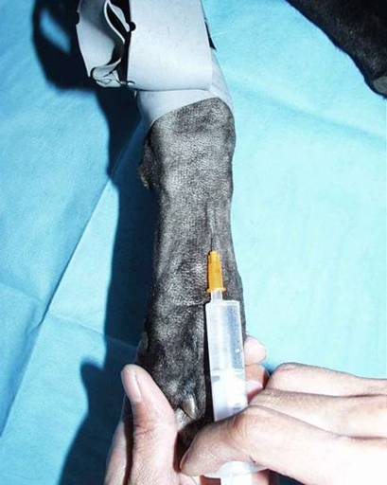
Regional intravenous anaesthesia
Throttle/turnstile
Bandage for bleeding

Slide 46
Nerve blockages on the fingers
Equipment
Sterile gloves, aids for preparation of the operating field
Syringes, needles
Lidocaine or bupivacaine
Blockade procedure
Insert the needle proximally in the interdigital lash of each finger
We inject a local anaesthetic

Slide 47
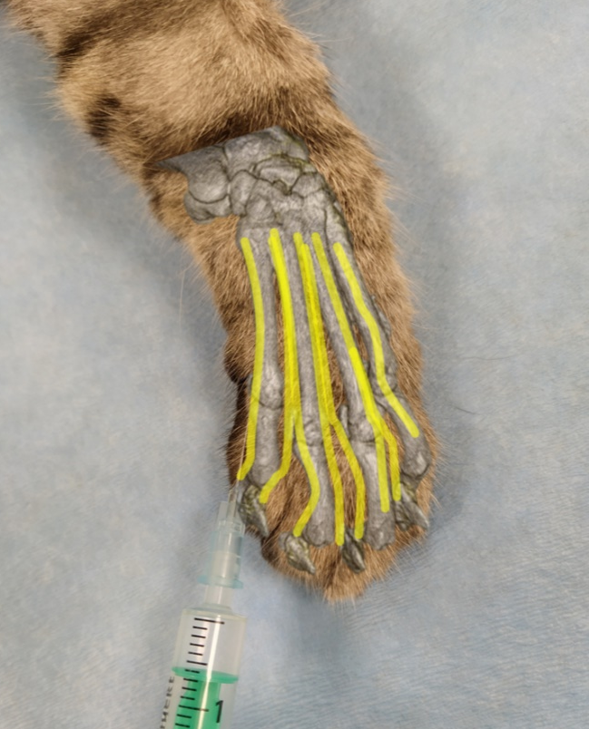
Nerve blockages on the fingers
The needle tip for the finger nerve block (yellow) is at the bifurcation (red)

